Slide 1
To Know from Tannen (2004)
Pets as IPC resources:
Buffer criticism
Shift frames
Deliver praise
Teach values
Mediate/avoid conflict
Reflect & constitute family ID

Slide 2
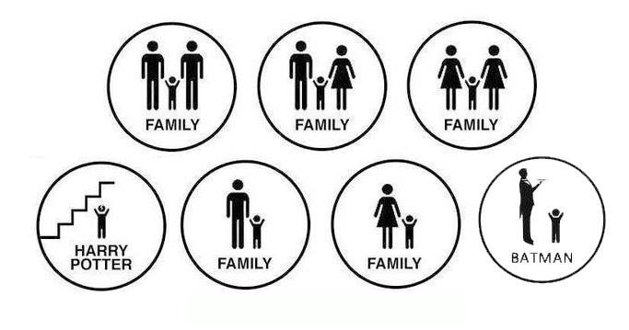
What IS vs How we DO FAMILY
vs

Slide 3
Grandparents Lifespan implications for family
Responsib’s OF
in GP-headed households
Outcomes for GPs:
Responsib’s FOR
“Who gets custody of Grandma?”
(Coleman & Ganong, 2011)
Predictors of getting help:
Length of

Slide 4
Extendeds
Aunts/Uncles
Geographic distance? (media)
Own kids?
Dependent on adult sibs’ relations
Cousins
In-Laws

Slide 5
Allen et al., 2011, p. 1164

Slide 6
Elective/Voluntary/Fictive Kin
Braithwaite et al. (2010) found voluntary kin as:
family
After
After
family
by blood/legal family as whole
Enacts in B/L family
Enacts role present, but in B/L family
Enacts role for
family
family

